Slide 1
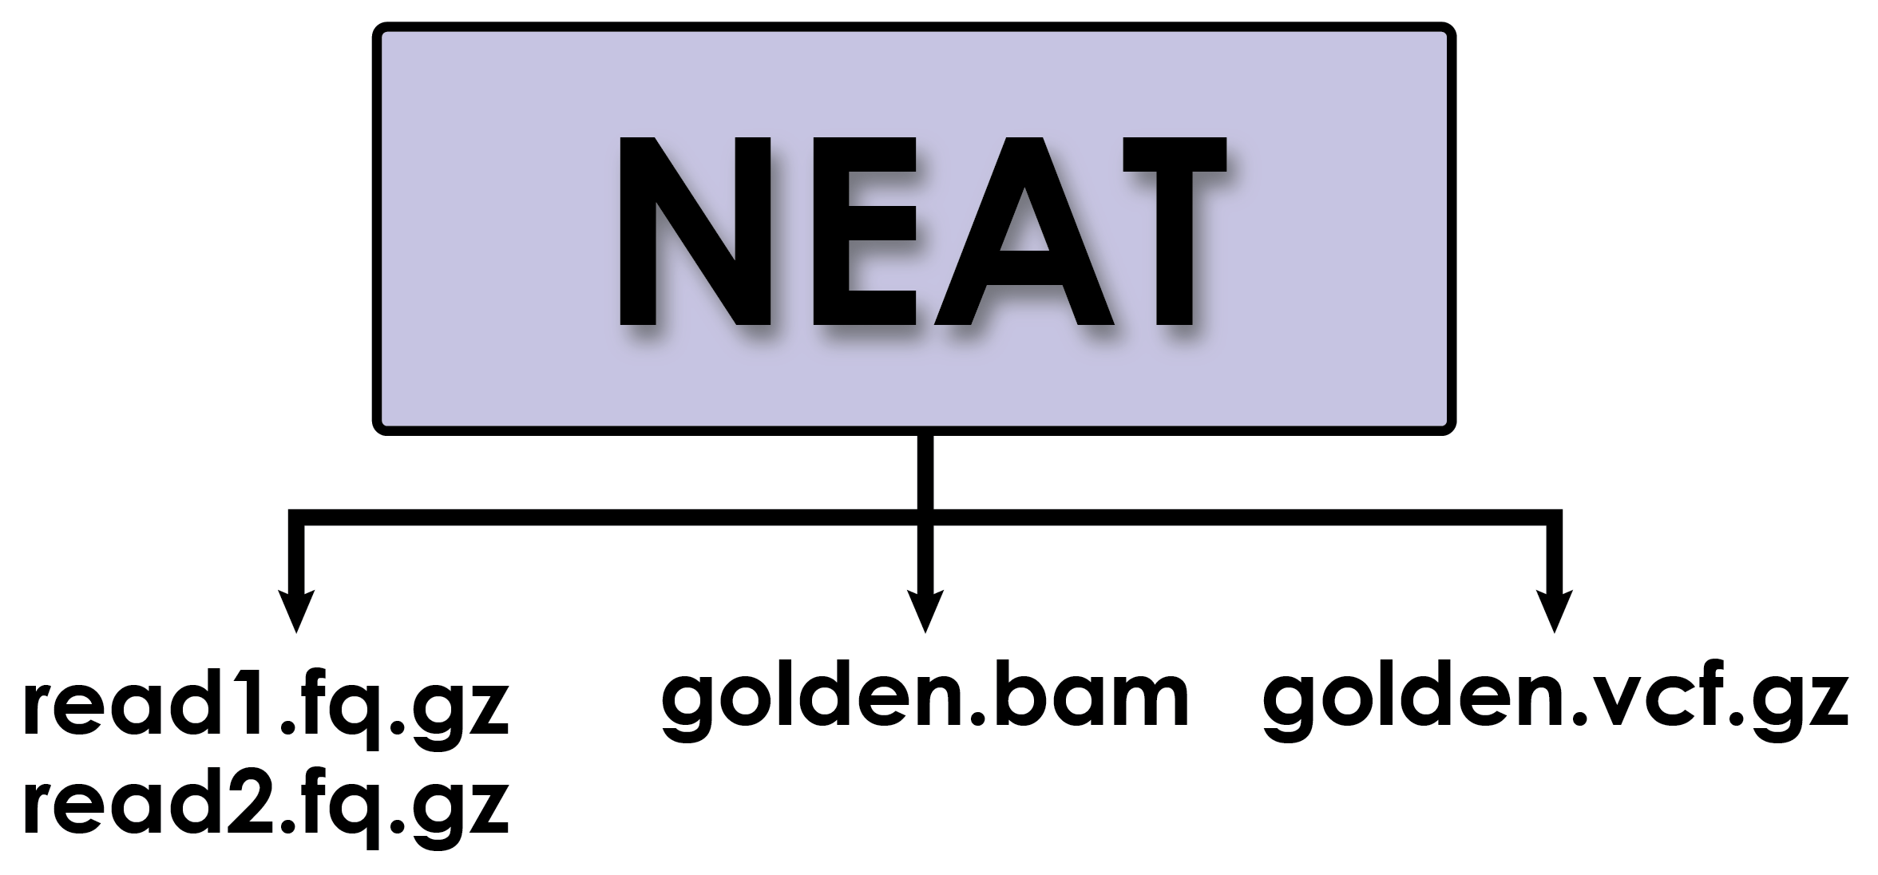
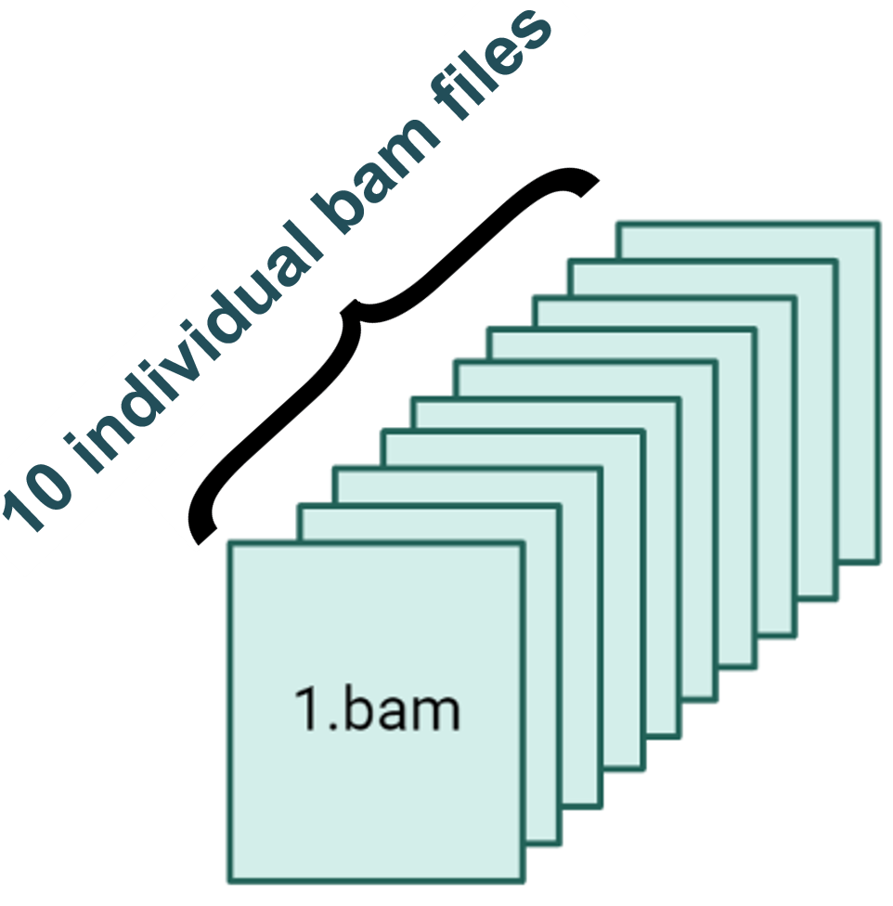

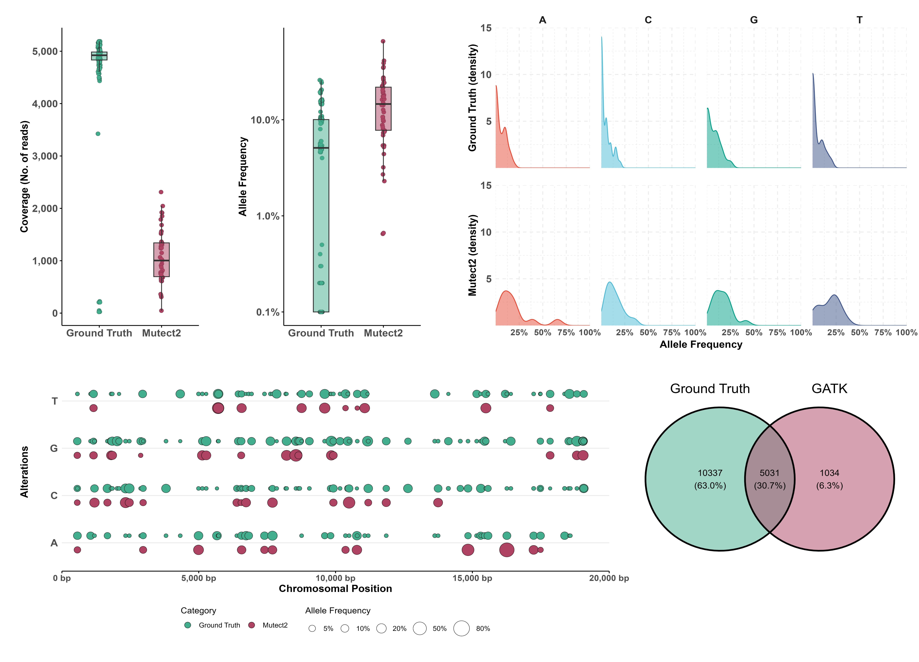
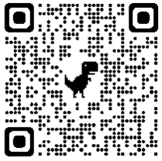








Synthetic Genomics Data Generation and Evaluation for the Use Case of Benchmarking Somatic Variant Calling Algorithms
Styliani-Christina Fragkouli^{1, 2}, Nikos Pechlivanis¹, Andreas Agathangelidis², Fotis Psomopoulos¹
¹Institute of Applied Biosciences, Centre of Research and Technology Hellas, Thermi, 57001, Thessaloniki, Greece
²Department of Biology, National and Kapodistrian University of Athens, Athens 10679, GR
1. Synthetic «Ground Truth» Dataset Generation
1
Highlights
Generation of synthetic genomics data based on TP53 gene
Define «Ground Truth» SNPs and INDELs in order to benchmark somatic variant callers
Investigate the impact of variant callers in variants at low frequencies
Merge bam files
x500 coverage
“Gold Standard” Variants of
100% Allele Frequency
x5000 coverage
“Gold Standard” Variants of
10% Allele Frequency
2. Benchmarking GATK-Mutect2
2
Down-sampling of coverage of «Ground Truth» Variants
Differences in AF of «Ground Truth» Variants
Variance in AF Density plots of «Ground Truth» Variants per DNA Base
Misrepresentation of information
.
Difficulty to identify variants at low frequencies
Venn plot of the Overall Variants
To learn more about our work please visit
Divergence in the identification of SNPs and their AF of «Ground Truth» Variants
sfragkoul@certh.gr
Funded by the European Union
sfragkoul
@scfragkoul
Horizon Europe Programme, Grant Agreement Number 101058573

